Slide 1


Slide 2

WELCOME TO SCHOOL FEE MANAGEMENT SYSTEM
2
+
2
+

Slide 3

2
+
2
+
2
+
INTRODUCTION OF SCHOOL FEE MANAGEMENT
2
+
Registered Since : 2021
Registration no: 330963

Slide 4
MEMBER’S DETAILS
PROJECT GROUP ID :- PRJ2333E
2
+
COLLEGE ROLL NO | REGISTRATION NUMBER | NAME | CONTACT NUMBER
21068 | 202143900321 | SUBAL ANAND | 7488804547
21094 | 202143900334 | VIKARN KUMAR JHA | 9199274757
21112 | 202143900309 | SATYAM KUMAR | 9341362668
21089 | 202143900332 | UTKARSH KUMAR | 8102763281
OWNER NAME :- ANIKET TIWARI
COMPANY NAME:-PRAGAYA HERITAGE INTERNATIONAL SCHOOL

Slide 5
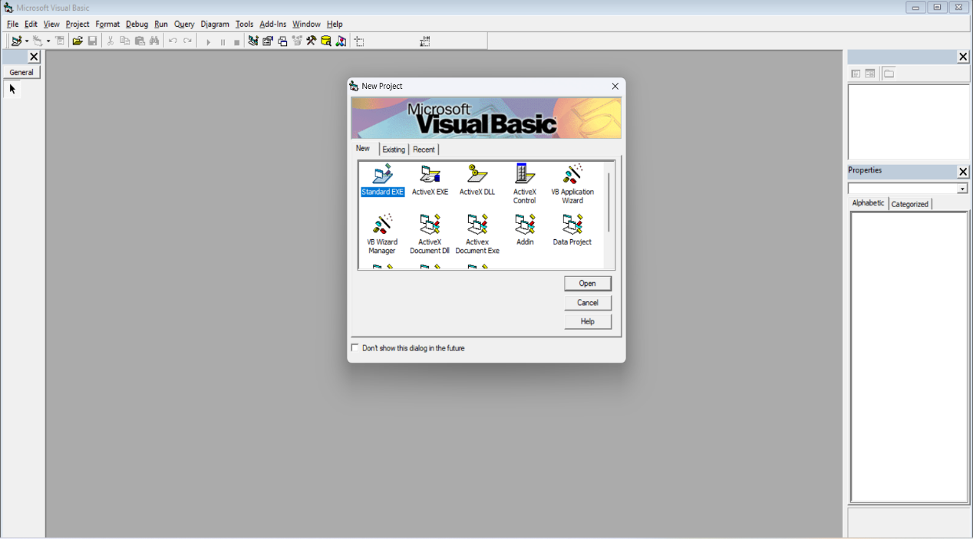
INTRODUCTION TO VISUAL BASIC 6.0
THE SECTION PROVIDES AN INTRODUCTION TO THE VISUAL BASIC 6.0 PROGRAMMING LANGUAGE AND EXPLAINS ITS RELEVANCE TO THE DEVELOPMENT OF THE SCHOOL FEE PROJECT SOFTWARE, HIGHLIGHTING ITS FEATURES AND BENEFITS FOR CREATING USER INTERFACES , INTEGERATING WITH ORACLE,AND ENHANCING THE OVERALL FUNCTIONALITY AND PERFORMANCE OF THE SOFTWARE

Slide 6
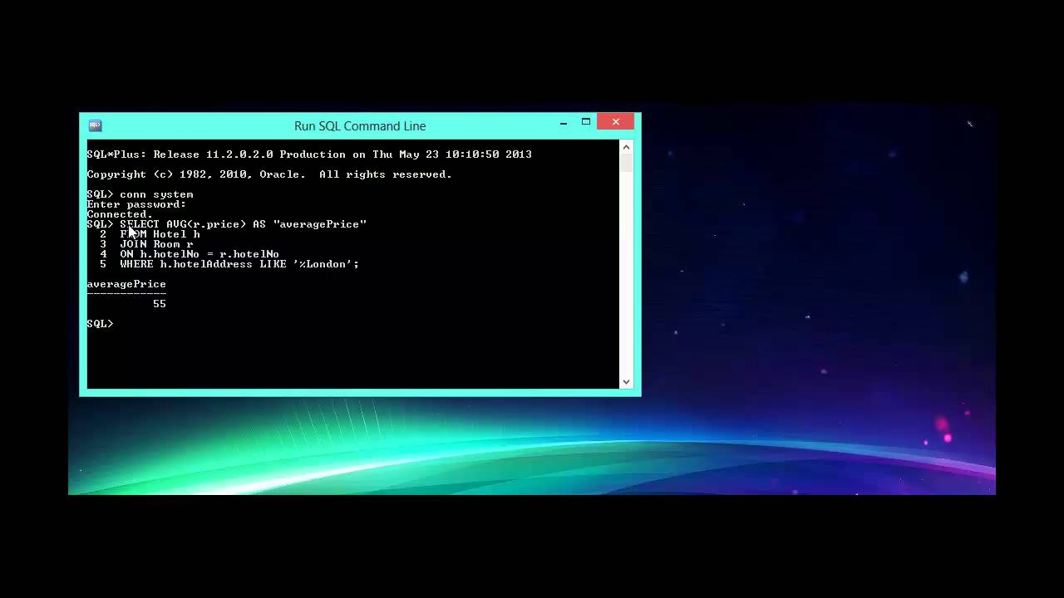
INTRODUCTION TO ORACLE DATABASE
ORACLE DATABASE IS A RELATIONAL DATABASE MANAGEMENT SYSTEM(RDBMS) THAT PROVIDES A COMPREHENSIVE AND INTEGRATED INFRASTRUCTURE FOR MANAGING AND STORING DATA. IT PLAYS A CRUICAL ROLE IN THE SCHOOL FEE PROJECT SOFTWARE BY PROVIDING A RELIABLE AND SCALABLE SOLUTION FOR STORING AND MANIPULATING DATA.

Slide 7
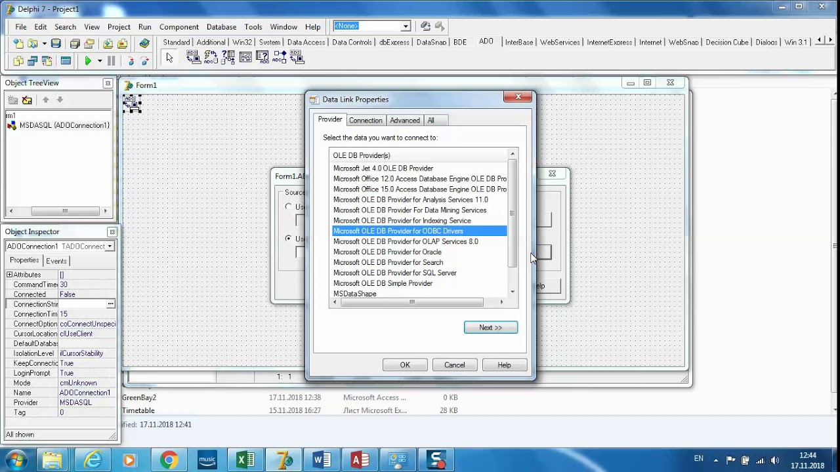
INTEGERATION OF VISUAL BASIC 6.0 WITH ORACLE
. TO INTEGRATE VISUAL BASIC 6.0 WITH ORACLE FOR THE SCHOOL FEES PROJECT SOFTWARE, WE NEED TO ESTABLISH A CONNECTION BETWEEN THE TWO, WRITE SQL QUERIES IN VISUAL BASIC, AND USE ORACLE DATA ACCESS COMPONENTS TO RETRIEVE AND MANIPULATE DATA FROM THE DATABASES

Slide 8


Nature of Processing
2
+
2
+
2
+
In a manual system, the organization of school fees processing typically involves creating paper records for each student, tracking payments and outstanding balances manually, and generating invoices and receipts using paper forms. This system can be time-consuming and prone to errors, as it relies on manual data entry and calculations.
To manage a manual system, schools may designate a staff member or team to oversee fee collection and payment. This staff member or team would be responsible for creating and maintaining paper records, collecting payments from students and parents, and reconciling payments with outstanding balances.
The organization of school fees processing in a manual system also involves ensuring compliance with relevant laws and regulations related to fee collection and payment. This may include maintaining accurate financial records, providing detailed receipts and invoices, and adhering to deadlines for fee payment.

Slide 9
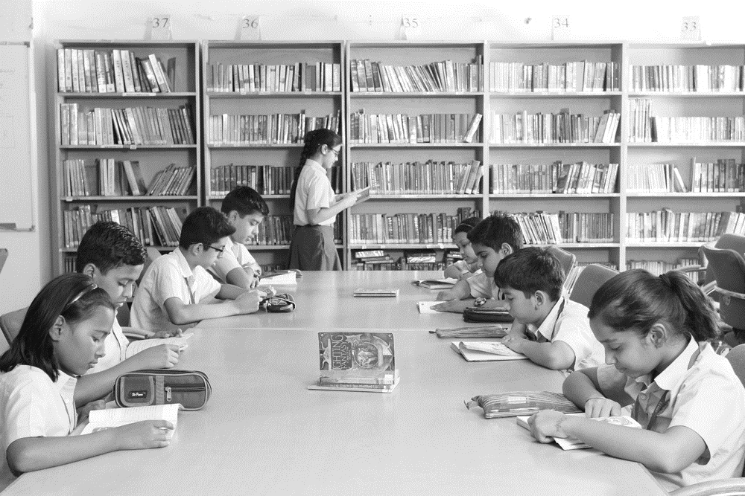
SERVICES
REGISTRATION FEE(One time):- At the time of admission.
ADMISSION FEE(One time):- At the time of admission.
MISCELLANEOUS FEE(As required):- As per requirement whenever an event is organized or fine is collected.
EXAMINATION FEE(Annual):- At the time of the admission Subsequently Before the start of each academic year.
TUTION FEE(Quarterly):- Deposit in the school office.
COMPUTER FEE(Quarterly):- Deposit in the school office.

Slide 10
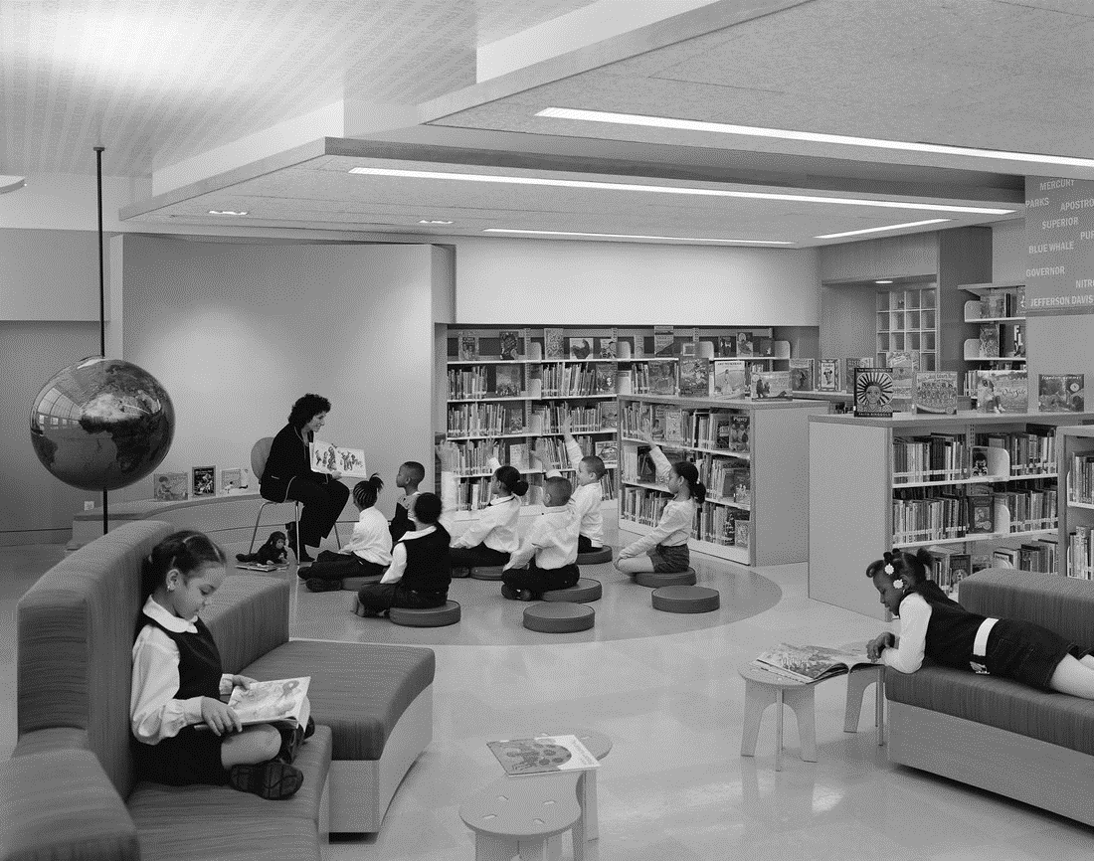
FUNCTIONS OF MANUAL SYSTEM
Fee collection: The manual system involves collecting fees from students and maintaining records of the same.
Fee calculation: The manual system involves calculating the fees for each student based on their class, subjects, and other factors.
Fee receipt generation: The manual system involves generating fee receipts for students after they have paid their fees.
Fee reconciliation: The manual system involves reconciling the fees collected with the records maintained to ensure accuracy.
Fee reminders: The manual system involves sending reminders to students and parents regarding pending fees
Fee reporting: The manual system involves generating reports on fee collections, outstanding fees, and other related data.
Fee records maintenance: The manual system involves maintaining records of all fee-related transactions for future reference.

Slide 11
2
+
LIMITATIONS OF EXISTING SCHOOL FEES SYSTEM
2
+
Lots of paperwork:- In an existing school fees system requires lots of paperwork and even a small transaction requires paperwork. Even any unnatural cause(such as fire in the school) can destroy all the data of the school fees. Loss of even a single paper laid to difficult situation because all the papers are interrelated.
Need more working staffs:- The work that can be easily done by system are to be done manually, that’s the disadvantage of existing system.
Acquire more space:- Keeping Files, registers possess more space which can be replaced by using storage(machines). And due to lake proper arrangement we need more files to storage data.
Searching slow:- Since, Data of any students are not in arranged way, searching of info is slow in existing system.
Manual Control:- It can cause error and human mistakes in document then loss of data will happens, it will impossible to recover it.
More security concern:- This system lacks very badly in security areas and there is no safety assurance of secret information. Since everything is in human hands access of data by an unauthorized person may be possible this is one of the most harmful drawbacks.

Slide 12
2
+
Objective of SCHOOL FEES SYSTEM software
2
+
Easy to maintain storage:- Due to computer work it is very easy to maintain the storage.
No need more employees:- In our software due to computer work we no need to more employee to performs the school fees task because a computer can do a very large work in a very short time that increases the company expenses.
Searching:- In our software the searching of any information can be fast as compared to manual system .
Data security guaranteed:- As we know that data is backbone of any school so every school wants that his data is must be secured. In us proposed system due to computer approach the data cannot be harm by physically.
Accuracy:- Computer work done can lead to accuracy in insertion of info/data in existing system.
Easy reports generating:- In the computer report can be easily generated and time to generate a report become less as compared to manual system.

Slide 13
2
+
HARDWARE AND SOFTWARE REQUIREMENTS
HARDWARE SPECIFICATIONS
PROCESSOR :- Pentium 90 MHZ or Higher
CPU SPEED :- 1.6 GHZ
RAM CAPACITY :- 256 MB of RAM
HARD DISK CAPACITY :- 100 MB or Free space
OPERATING SYSTEM CONFIGURATION
NAME :- Windows 7 OR Above

Slide 14

MODULES
User management module: This module login administrator to access the dashboard.
Class module: This module give an option to the administrator to see all class student report.
Student module: This module allows administrator to registration the details of new students and the creation of their profiles.
Student dues: This sub module give an option to check dues of a particular student.
Fee payment module: This module gives the payment detail from all the other modules
Report module: This module generates reports on fee collections, outstanding fees, and other related data.
Fee receipt generation process : This process generates fee receipts for students after they have paid their fees.
Student details table : This table gives the structure of student details.
Fee structure table: This table gives the structure of fee detail to pay the bill by the users.
Fee payment status table: This table shows the status of fees paid by the users.

Slide 15

2
+
Milestones
2
+
 | GANTT CHART(Time Scheduling Chart)
 | SEP | OCT | NOV | DEC | JAN | FEB
Analysis Preliminary Investigation Feasibility study Costing Synopsis
Design
Coding
Testing
Documentation

Slide 16
PROJECT PLANNING
PHASES | MEMBERS | TOTAL DAYS
ANALYSIS PRELIMINARY INVESTIGATION FEASIBILITY STUDY COSTBENEFIT ANALYSIS SYNOPSIS | SUBAL ANAND VIKARN KUMAR JHA SATYAM KUMAR UTKARSH KUMAR | TOTAL DAYS + 40% = 73 DAYS
DESIGN | SUBAL ANAND SATYAM KUMAR VIKARN KUMAR JHA | TOTAL DAYS + 15% = 27 DAYS
CODING | SUBAL ANAND SATYAM KUMAR VIKARN KUMAR JHA | TOTAL DAYS + 25% =47 DAYS
TESTING | SUBAL ANAND VIKARN KUMAR JHA | TOTAL DAYS + 15% = 24 DAYS
DOCUMENTATION | SUBAL ANAND VIKARN KUMAR JHA SATYAM KUMAR UTKARSH KUMAR | TOTAL DAYS +5% = 11 DAYS
2
+
Start date:- 01-09-2023
Last date:- 29-02-2024
Total days:- 182 Days
Total weeks:- 26 Weeks
Months:- 6 Months

Slide 17
2
+
FUTURE SCOPE OF THE SCHOOL FEE MANAGEMENT SYSTEM
2
+
The future scope of a school fees management system is vast and promising. With the increasing demand for automation and digitalization in the education sector, such software can prove to be a game-changer for schools and educational institutions. Some of the potential future scopes of this software are:-
Integration with other school management system:- The school fees management system can be integrated with other school management systems like attendance management , grade management, and student information management. This will help schools to have a complete overview of the operations and make informed decisions.
User Interface (UI): Design a user-friendly and intuitive interface for administrators, parents, and students.
Reports: Design reports for generating fee-related documents, such as invoices, fee receipts, outstanding balance reports, and financial summaries.

Slide 18
2
+
FUTURE SCOPE OF THE SCHOOL FEE MANAGEMENT SYSTEM
2
+
Payment Reminders Report: This will be generate report so that administrator can use this report to notify parents and students about upcoming fee due dates via school fee department.
User Login: Implement user authentication and authorization to give access to student so that student can show their reports.
Backup and Restore: Develop a mechanism for data backup and restoration to prevent data loss in case of system failures.
Error Handling: Implement error handling routines to gracefully handle unexpected errors and exceptions.

Slide 19
THANK YOU
2
+
2
+

